Slide 1








DATA ANALYSIS
Module 4: Statistic for Analytics
Correlation and
Relationships
Topic 2 of 5
Notes:
1.7.2013
‹#›

Slide 2


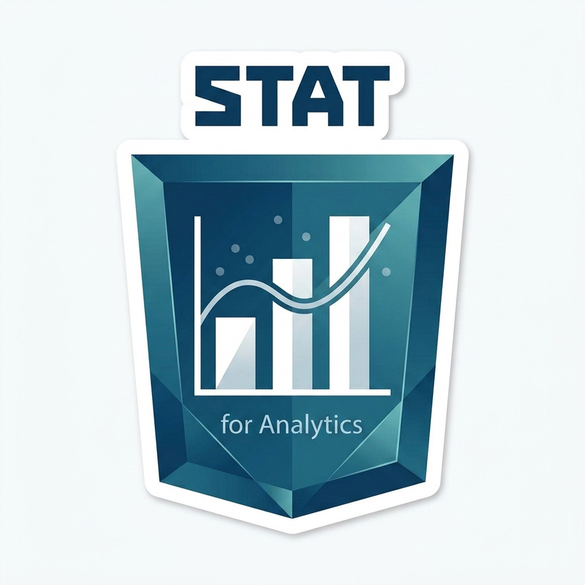


Learning outcome
By the end of this topic, the you can…
1- Calculate a correlation coefficient in Excel and describe what it measures.
2- Interpret the strength and direction of a correlation coefficient in business language.
3- Explain, with a concrete example, why correlation does not prove causation.
4- Identify a spurious relationship and suggest what might really be driving it.
Notes:
1.7.2013
1.7.2013
‹#›
‹#›

Slide 3

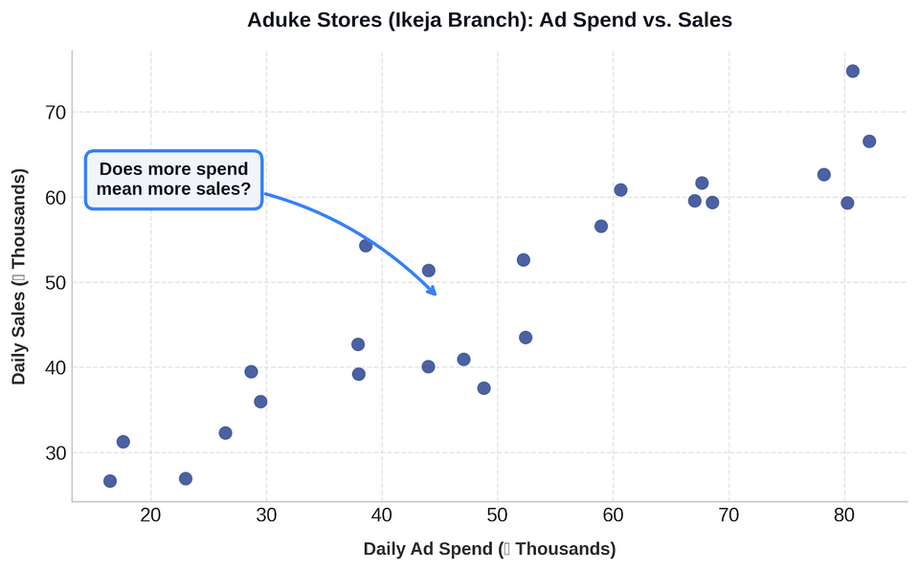
Should Aduke Stores Spend More on Ads?
The Aduke Stores marketing team ran a 24-day experiment at the Ikeja branch: each day, they spent a different amount on social media ads, then recorded that day's total sales.
The marketing manager wants a straight answer: "If we spend more on ads, do we actually sell more? Or are we just hoping so?"
A gut feeling is not good enough for a budget decision.
The manager needs an objective number that measures the relationship honestly. That is what correlation provides!
Notes:
1.7.2013
1.7.2013
‹#›
‹#›

Slide 4
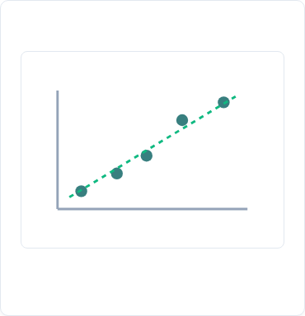
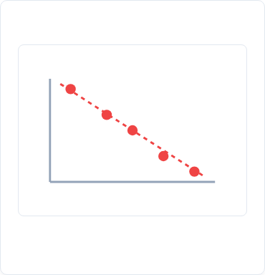

What is a Relationship Between Two Variables?
So far, Topic 4.1 described one variable at a time (e.g., daily sales). A relationship exists when two variables tend to move together. A scatter plot places one variable on each axis to visually reveal patterns.
1. Positive Relationship
2. Negative Relationship
3. No Relationship
As X increases, Y tends to increase (dots trend upward from left to right).
As X increases, Y tends to decrease (dots trend downward left to right).
Dots are scattered with no clear pattern or direction visible.
Notes:
1.7.2013
1.7.2013
‹#›
‹#›

Slide 5

The Correlation Coefficient (r)
The correlation coefficient (r) is a single number measuring how strongly and in which direction two variables move together.
Business Translation Example
▪
Calculates: How closely dots follow a straight line.
"r = 0.78 means marketing spend and sales at Ikeja branch move together fairly strongly. Higher-spend days tend to be higher-sales days too, though not perfectly, so spend is not the only factor at play."
▪
Value Range: Always falls between −1 and +1.
▪
In Excel: Formula is =CORREL(range1, range2), where range1 is one variable's column of values and range2 is the other variable's column, for the same days.
▪
When to use: Whenever asked "does X affect Y?" as a starting step before regression.
−1.0 (Strong Negative) 0.0 (No Relationship) +1.0 (Strong Positive)
Indicator showing Ikeja's r = 0.78 position on scale
Notes:
1.7.2013
1.7.2013
‹#›
‹#›

Slide 6
Reading the Strength of r: A Rough Guide
While cut-offs vary across industries, analysts commonly use this guide when presenting findings to non-technical stakeholders:
Strength Band
Practical Business Interpretation
Value Range (|r|) | Strength Band | Practical Business Interpretation
0.0 to 0.2 | Very Weak / None | Virtually no linear relationship. Do not act on this.
0.2 to 0.4 | Weak | Worth noting, but not strong enough to bet a major business decision on alone.
0.4 to 0.7 | Moderate | Meaningful connection, but other business factors are clearly involved.
0.7 to 1.0 | Strong | The two variables move together closely. Strong signal for decision-making.
Professional Habit: Always state both the number and what it means in plain terms. "r = 0.78" means little to a branch manager alone. "A strong positive relationship—spend and sales rise together" drives action.
Notes:
1.7.2013
1.7.2013
‹#›
‹#›

Slide 7

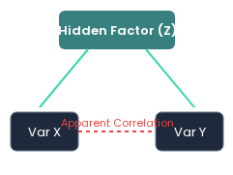

Correlation is NOT Causation
Correlation tells you two variables move together. It does NOT prove that one causes the other. Two variables can correlate due to:
The Confounding Factor Structure
1.
Direct Cause: X actually causes Y (or Y causes X).
2.
Confounding Variable: A third, hidden factor causes both.
3.
Coincidence: Random chance, especially in small samples.
Classic Ice Cream Example
Ice cream sales and sunburn cases both rise in the same months. Eating ice cream does not cause sunburn—hot, sunny weather drives both!
This is one of the most important professional habits in this whole programme: a strong correlation is a reason to investigate further, never a reason to announce a cause.
Notes:
1.7.2013
1.7.2013
‹#›
‹#›

Slide 8

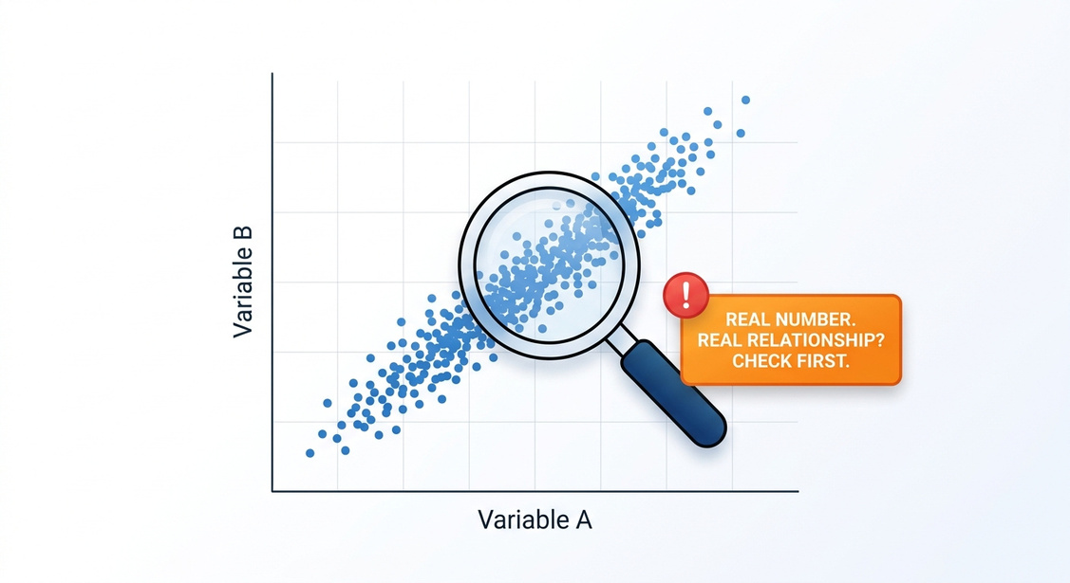
Spurious Relationships: When Numbers Lies To You
A spurious relationship is a correlation that is statistically real (the number is calculated correctly) but practically meaningless or misleading, because there is no genuine direct connection between the two variables.
How to protect yourself and your reports:
1.
Before reporting a strong correlation, ask: "Is there a believable reason X would directly affect Y?"
2.
Ask: "Could a third factor explain both?" (Weather, seasonality, day of the week, and public holidays are common hidden drivers in Nigerian retail data.)
Spurious relationships often appear when both variables are driven by the same underlying, unrecorded factor, or when a small sample happens to line up by chance.
3.
Never present a correlation to a manager without this check. A confident wrong conclusion is worse than no conclusion at all.
Notes:
1.7.2013
1.7.2013
‹#›
‹#›

Slide 9
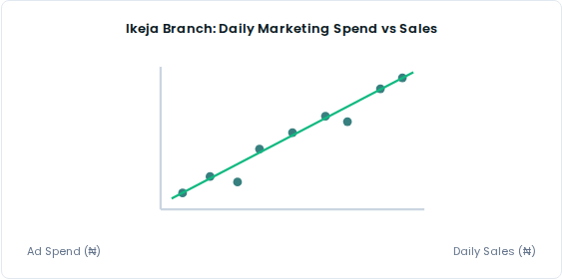


Aduke Stores (Ikeja Branch): Ad Spend vs Sales
Dataset: 24 days (Dec 2025). Daily ad spend: ₦8,500 – ₦69,500.
Excel Formula:
Result: r ≈ 0.78
Strength Band: Strong positive relationship (0.7 – 1.0).
Business Interpretation:
"Higher ad spend days at Ikeja branch were fairly reliably higher sales days too. This provides reasonable basis to test a modest budget increase, while remembering that r = 0.78, not 1.0, so footfall & stock availability still play key roles."
Notes:
1.7.2013
1.7.2013
‹#›
‹#›

Slide 10



Your Turn: A Weaker Signal at Yaba Branch
Pair Exercise Instructions
Open the Yaba branch marketing dataset (24-day experiment identical to Ikeja).
1.
Calculate correlation coefficient between marketing spend and daily sales using .
2.
Identify which strength band this falls into.
3.
Write 1 sentence to the Yaba branch manager who asks: "Should we copy Ikeja's ad strategy?"
Notes:
1.7.2013
1.7.2013
‹#›
‹#›

Slide 11

Key Takeaways
Scatter Plots & CORREL: Build scatter plots and calculate correlation coefficients in Excel using =CORREL.
Strength & Business Language: Read strength/direction and explain findings in clear, actionable business language.
Up Next:
Regression Fundamentals
Correlation vs Causation: Explain using examples why correlation does not prove direct causation.
Spot Spurious Relationships: Identify spurious correlations and uncover plausible underlying hidden factors.
Notes:
1.7.2013
1.7.2013
‹#›
‹#›

Slide 12
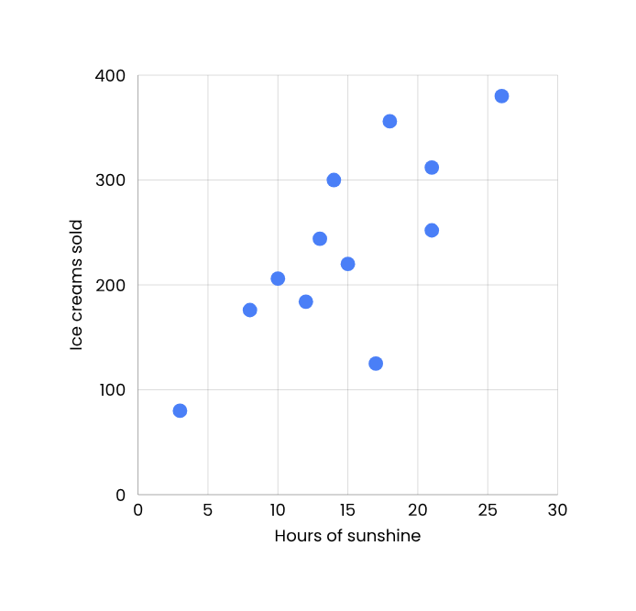

Up Next: Topic 4.3 — Regression Fundamentals
Today you measured how strongly two variables move together. Topic 4.3 goes one step further: building a model to predict exact values!
Before Next Session:
•
Complete Topic 4.2 lab exercise (Guided & Semi-Guided).
•
Complete LMS practice questions on publica.academy.
•
Keep your Ikeja & Yaba workbooks—Topic 4.3 builds models directly on this data!
Notes:
1.7.2013
1.7.2013
‹#›
‹#›

